Slide 1
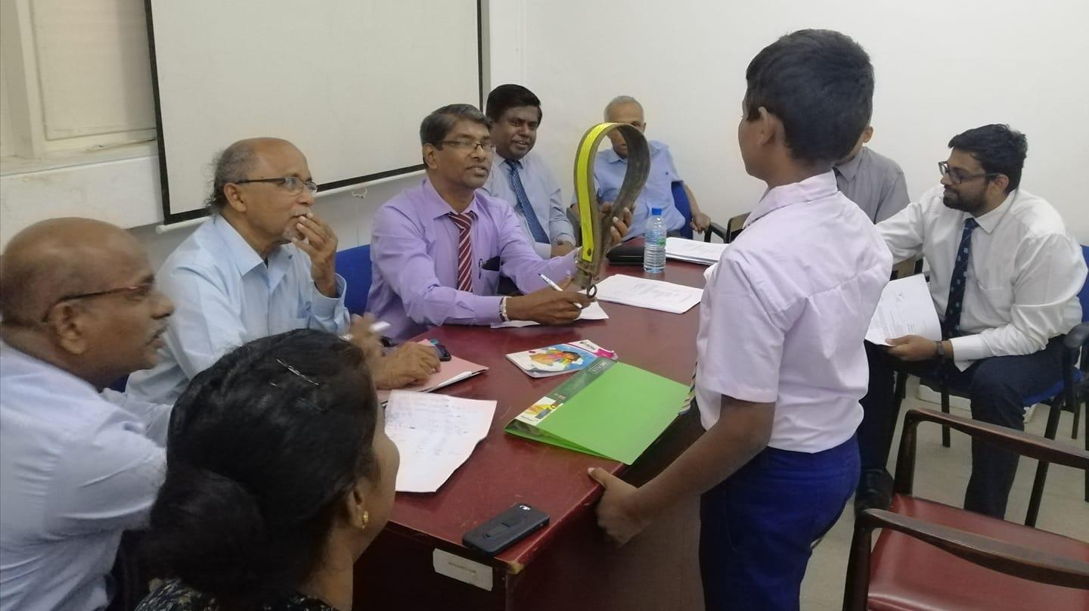


IESL - JUNIOR INVENTOR OF THE YEAR 2022
ROAD MAP
Young Inventors for a Better Future…
INSTITUTION OF ENGINEERING, SRI LANKA
120/15 Wijerama Mawatha, Colombo 7

Slide 2
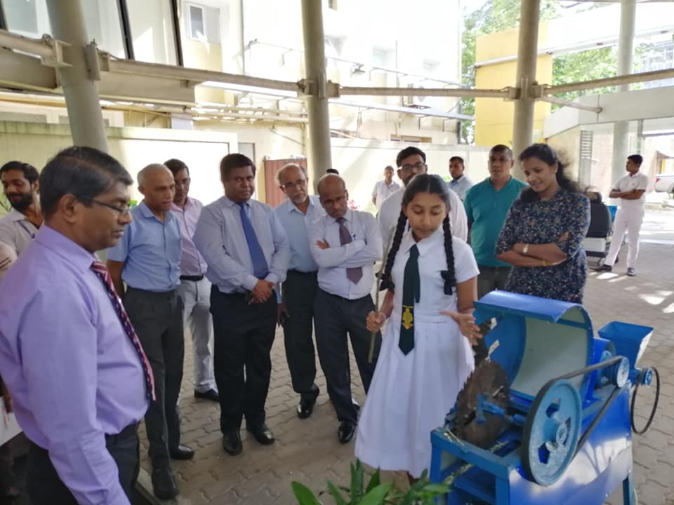
OBJECTIVES
Bringing the essence of the,
Junior Inventor of the Year 2022 Competition,
By the Institution of Engineers Sri Lanka(IESL)
To the School Apprentices
IESL JIY
2022
02

Slide 3
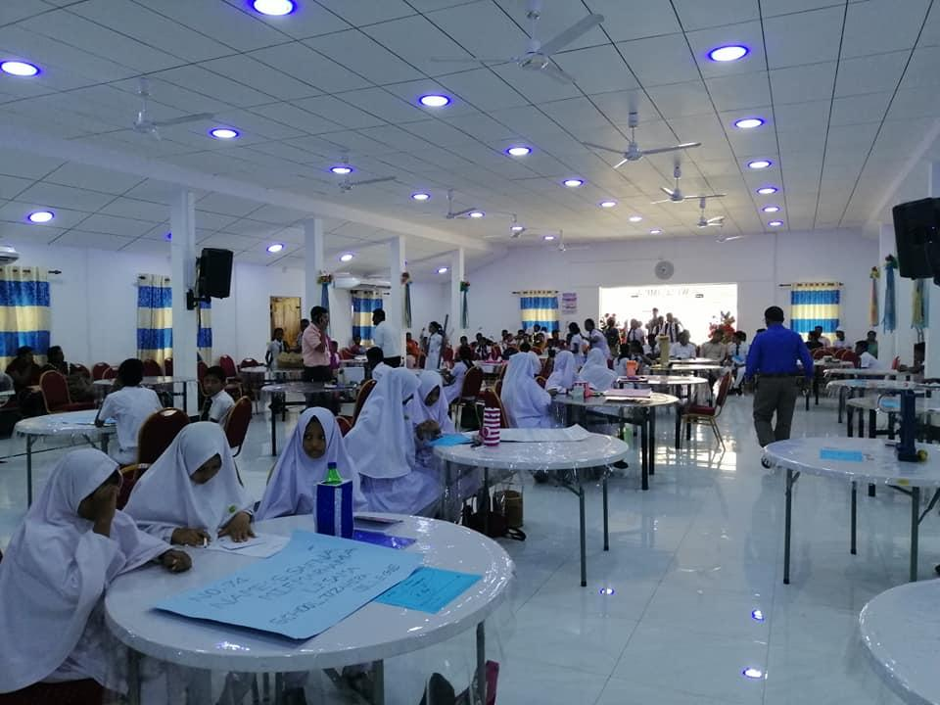
OVERVIEW
Introduction to IESL
Introduction to
IESL- JIY
Benefits of the Competition
Introduction to Past Winners
How to Prepare
IESL JIY
2022
Duration -
03

Slide 4
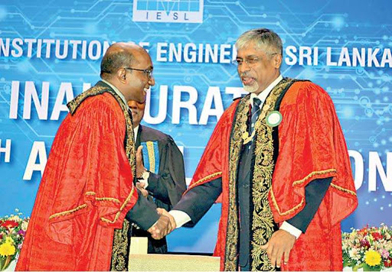
Institution of Engineers Sri Lanka (IESL)
Vision
Be amongst the leading professional institutions in engineering and technology in the world
Established in 1906 as the Engineering Association of Ceylon
Revolutionized into the Institution of Engineers, Ceylon, in 1956
Upgraded to the Institution of Engineers, Sri Lanka in 1996
IESL JIY
2022
04
Notes:
sri lanka engineeru aayathanaya/ wishishta nirmana/ engineeru sheshthrya nanwaleema/ engineering faculties

Slide 5


About Ourselves
Mission
To be the apex national body of engineers in Sri Lanka which ensures internationally recognized and locally relevant standards in the professional practice and education in engineering, while actively supporting national development and diligently serving its members and the society at large.
Composition
Total Membership - 20,248
Corporate Members - 5,230
Fellow - 526
Honorary Fellow 3
Associate Members - 11,594
Affiliate Members – 145
Companions – 9
Associates – 32
Student Members - 2,709
Functional Arms
Engineering Sectional Committees
Overseas Chapters
Provincial Chapters
University Chapters
Forums
IESL JIY
2022
05
Notes:
dawantha aayathanayak

Slide 6
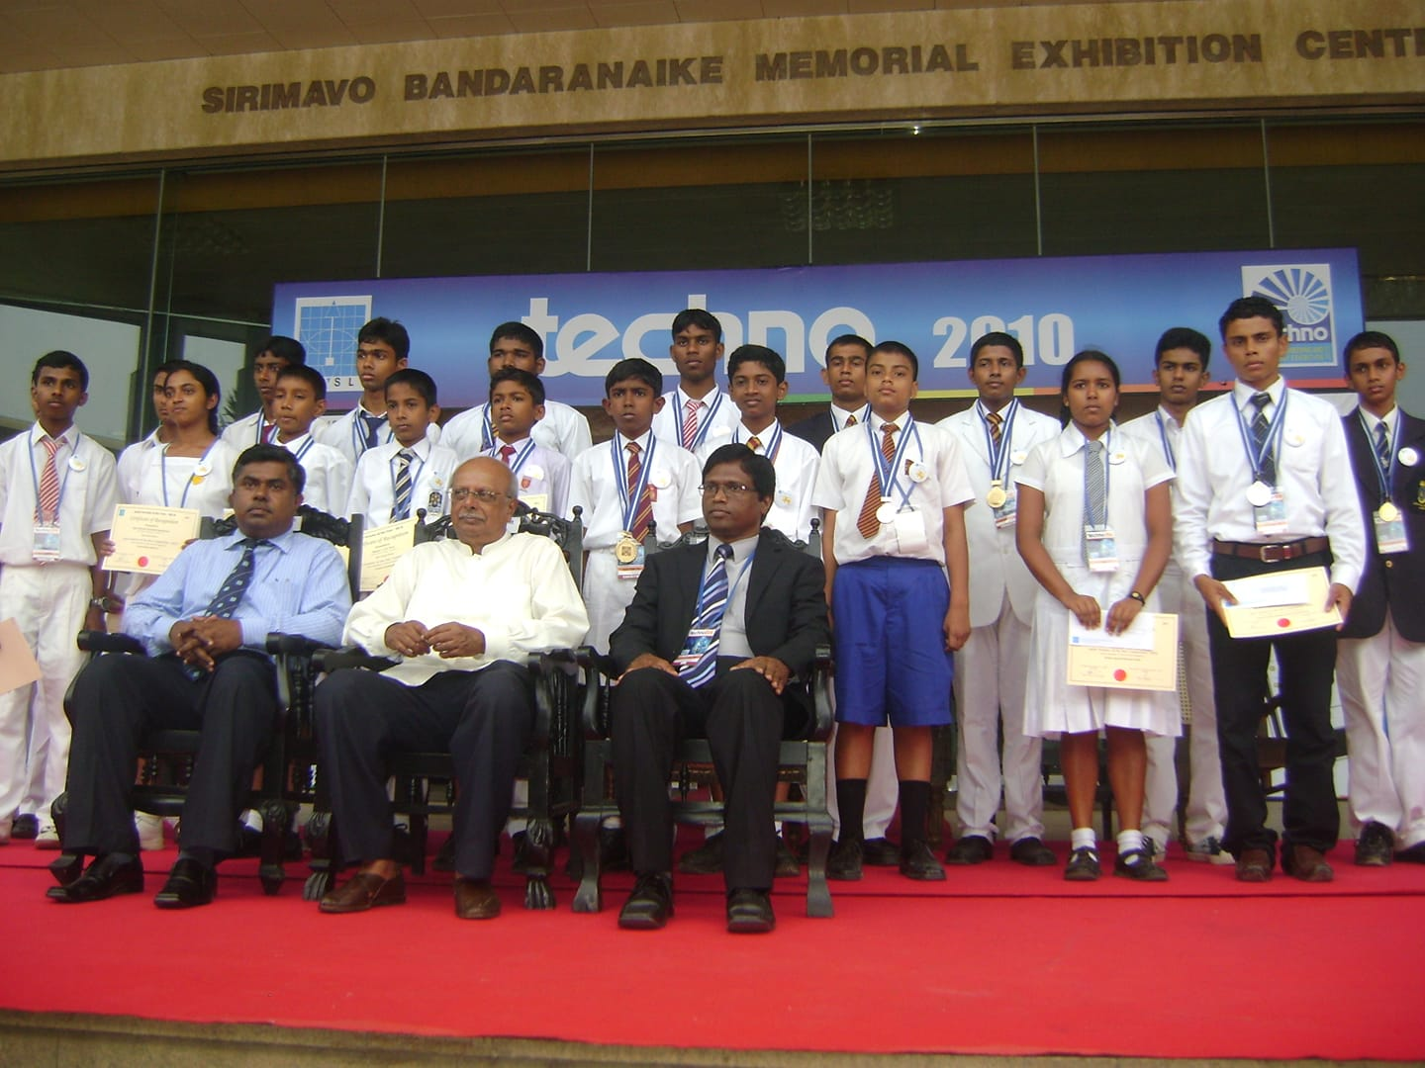
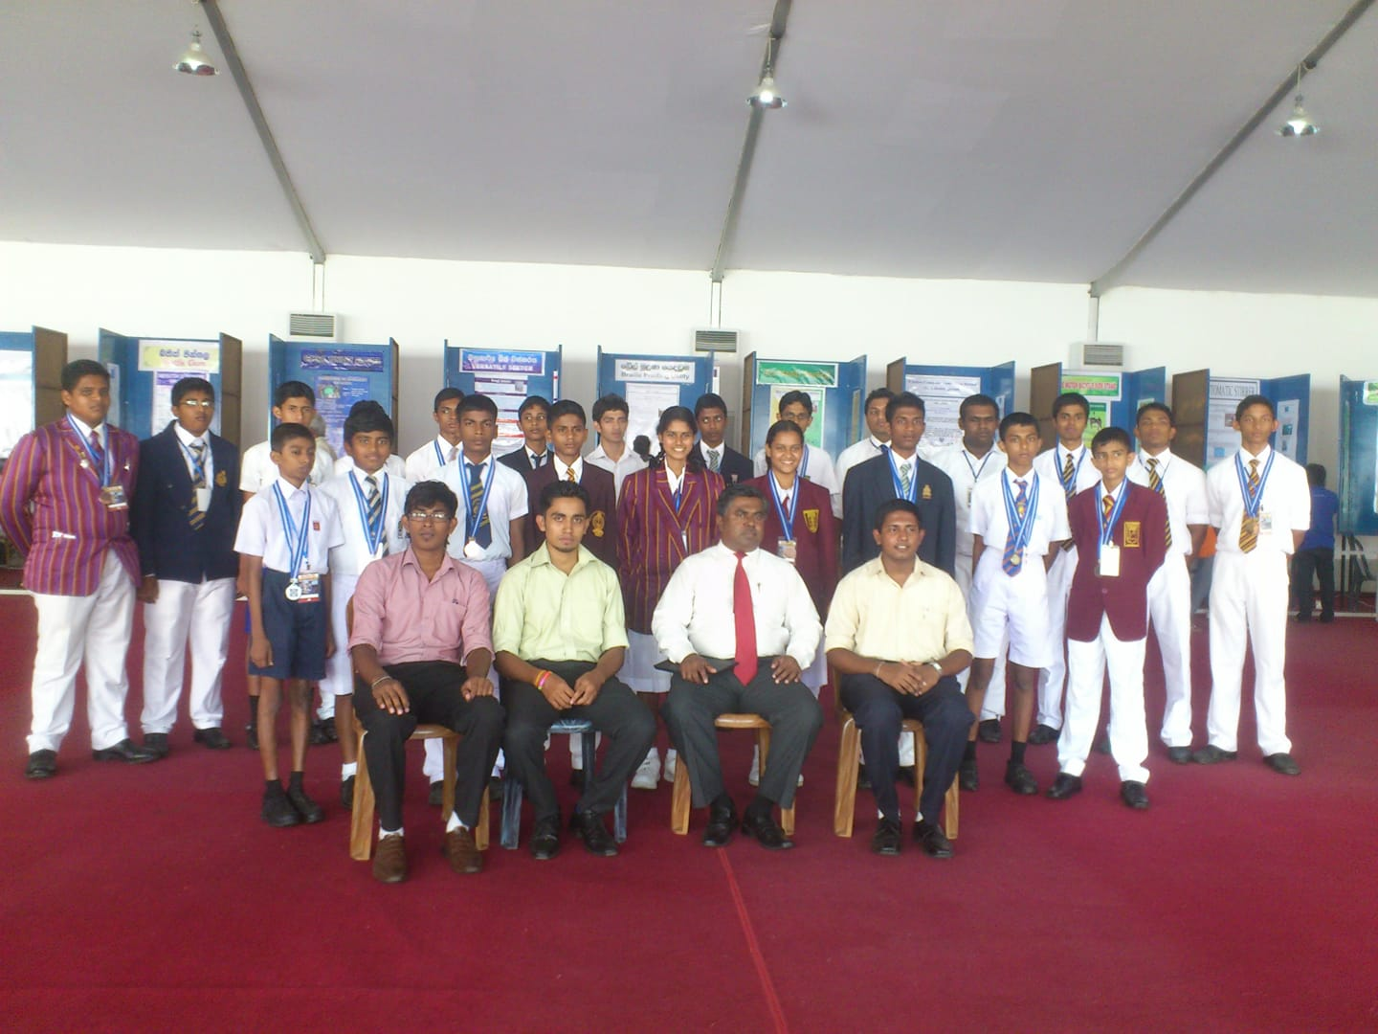
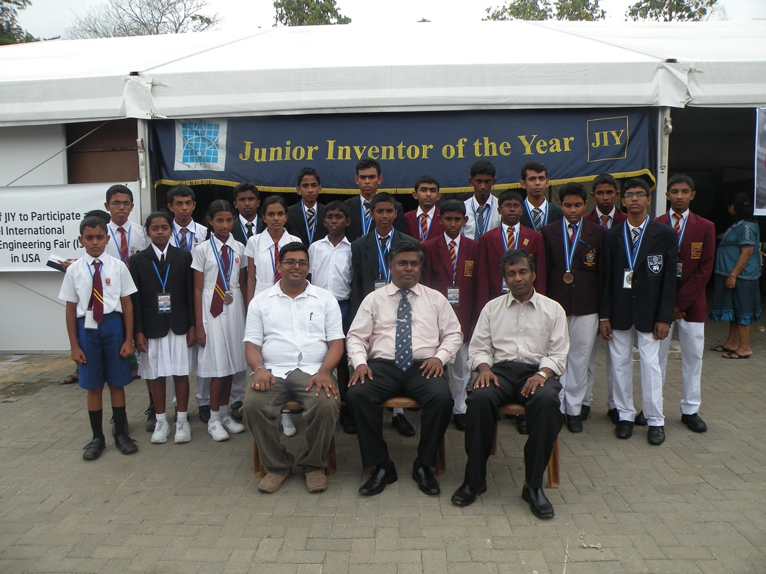
Junior Inventor of the Year (IESL – JIY)
Young Inventors for a Better Future…
VISION
Encouraging Innovation in Engineering and Technology, Amongst School Children in Sri Lanka
WHAT IS IT?
An annual competition organized by IESL, Island-Wide
To Promote Creative and Innovative Thinking amongst the school children in Sri Lanka
Initiated in 1980
Open to all Sri Lankan students pertaining to the age group of 12-19
IESL JIY
2022
06
Notes:
1890 arambaya/ 41 waratath 2021/ nirmanaya ha nawa chinthanaya mulu loketama pennemaa/ aurudu 12-19

Slide 7
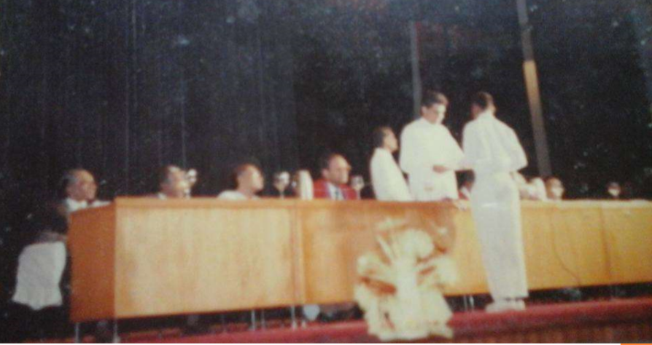
History and Broadcast of the Competition
Initiation
In 1980, IESL HQ, Colombo
1980-2000
Annually 50 Inventors, IESL HQ, Colombo
Provincial Awareness Programs
Pioneered in Sabaragamuwa and Central Provinces, back in 2000
Provincial Level Competitions
Pioneered in Sabaragamuwa Province, back in 2002
Provincial Awareness Programs
Expanded in Uva Province in 2003
Introduction of Scholarship Schemes
Introduced back in 2004 for JIY Winners.
First Ever JIY Competition in 1980
Residential Workshops
Initiated in 2005 for the competition Applicants
IESL JIY
2022
07
Notes:
palathen palathata wyaptha una

Slide 8
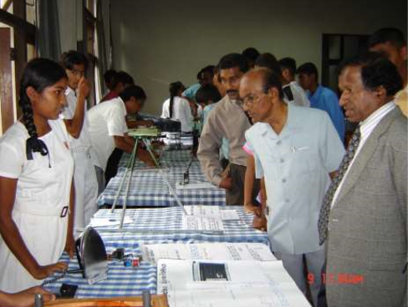
History and Broadcast of the Competition (Cont.)
Provincial Competition
Expanded to North-Central Province in 2005 Expanded
Approach to Exhibitions
Inventions by finalists were displayed at National Engineering Exhibitions in 2006
In 2006
Selection of Best School and Best teacher was brought to the competition
Expand of the Provincial Competition and Awareness Program to Southern Province
Engaged with National Engineering Research Development Center (NERD)
Engaged with University of Moratuwa (UOM)
In 2007
Affiliated to Sri Lanka Science & Engineering Fair with collaboration of IESL, MOE, Intel Sri Lanka and National Science Foundation
Affiliated with Intel International Science & Engineering Fair (Intel ISEF)
National Engineering Exhibition in 2006
IESL JIY
2022
08
Notes:
jathika engineeru pradarshanaya

Slide 9
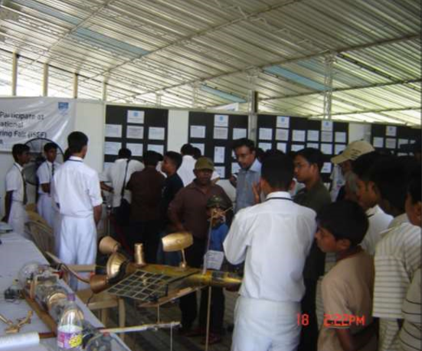
History and Broadcast of the Competition (Cont.)
In 2008
JIY stall became the most visited stall in the National Engineering Fair
Award ceremony took place at the National Engineering Exhibition – Techno
Scholarship & certificate award ceremony was held at the IESL annual sessions
In 2009
Provincial Awareness Program and the Competition was expanded to Northern and Eastern Provinces
JIY Stall in National Engineering Fair, in 2008
IESL JIY
2022
09

Slide 10
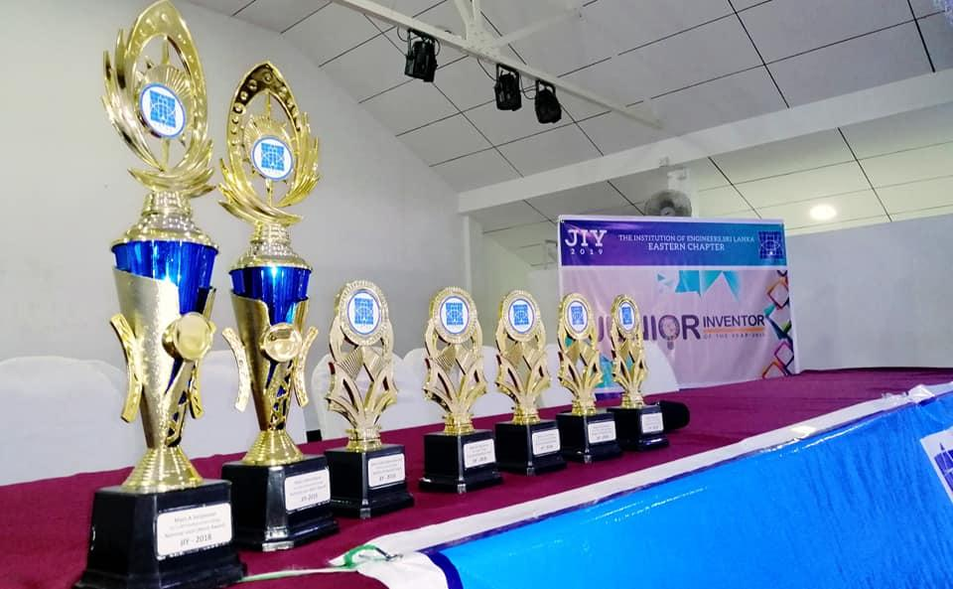



Through JIY, You Stand to Win
Exclusive Cash Prizes and Awards
Research Internships
Scholarship Opportunities
IESL JIY
2022
10
Image Courtesy – Google Images

Slide 11
Participation
North Central Province
200 Participants
Northern Province
150 Participants
IESL – JIY Competition secured over 1500 Competitors at Provincial Preliminarily Levels (2019).
Among the 1500 preliminary participants, 60 were selected To participate in the Final Competition
The Most distinguished 20 among the 60 , gained the opportunity to display their produces, in National Engineering Exhibition – Techno
Northwestern Province
Central Province
150 Participants
300 Participants
Western Province
Eastern Province
300 Participants
100 Participants
Sabaragamuwa Province
Uva Province
100 Participants
100 Participants
Southern Province
IESL JIY
2021
100 Participants
11

Slide 12

Road Map of the Competition
Provincial Preliminary Levels of the Competition
Workshops and Awareness Sessions for the Selected 60 Students
Final Competition to Select 20 Students
Techno Exhibition
IESL JIY
2021
12
Notes:
jthika engineeru pradarshanaya

Slide 13
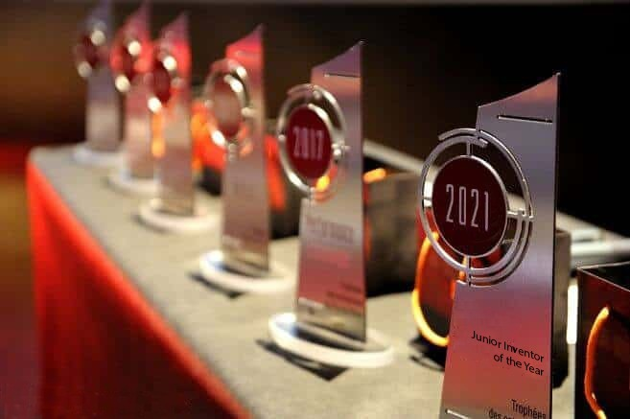

Benefits Of The Competition
Junior Inventor of the Year
Best invention for
day-to-day life usage
Most Innovative Team of the Year
Best invention for energy saving
Six Special Titles
Best invention for ensuring personal safety
Exclusive Scholarships
Research Internships
Best invention for improving efficiency.
Best Teacher Award
Best environmentally friendly invention
Best invention done using local raw material
IESL JIY
2021
13

Slide 14

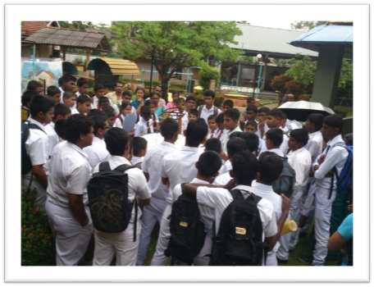
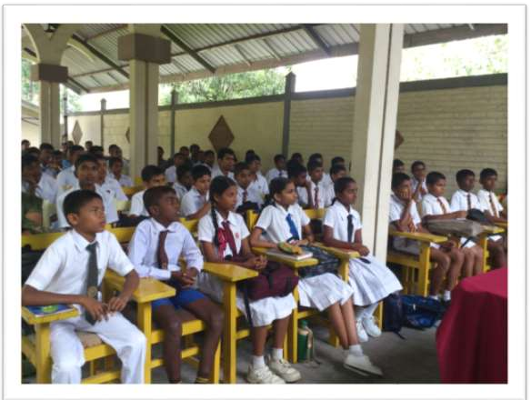
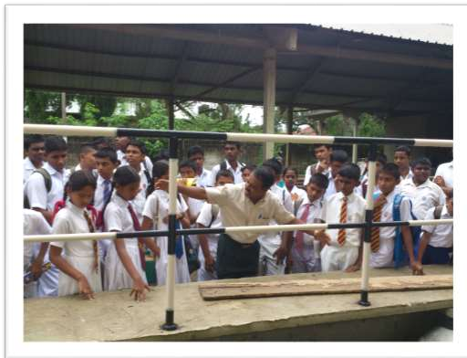
Baljsdkasbddljbdlab
Workshops for JIY Finalists at NERD
What is NERD ?
National Engineering Research and Development center of Sri Lanka is the platform for engaging in Research and Development activities to develop, acquire, adapt and transfer Engineering Technologies that would have a direct impact on the Socio-Economic Development of Sri Lanka.
IESL JIY
2021
14
Notes:
jatika engineeru paryeshana ha sanwardana ayathanaya/ wadamulu

Slide 15

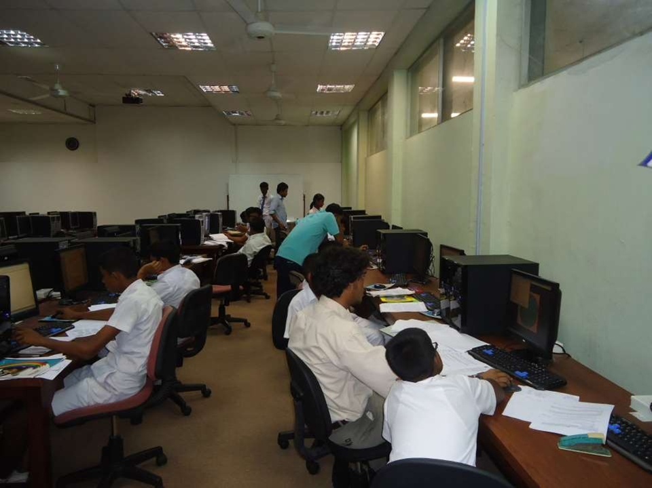
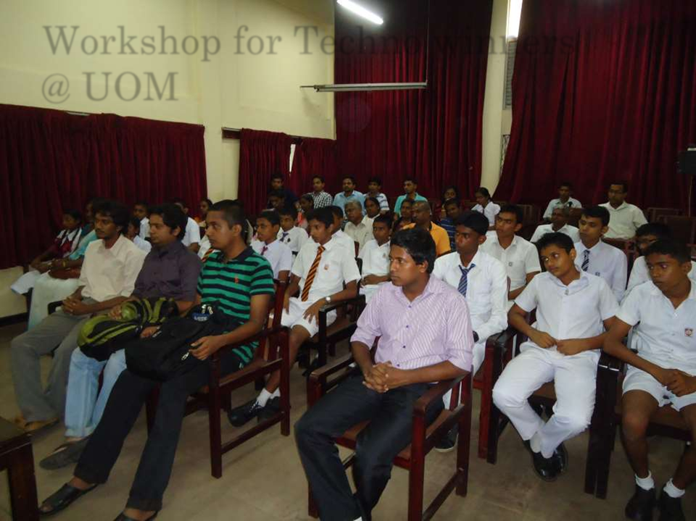
Workshops at University of Moratuwa
Finalists of JIY are entitled to experience exclusive workshops at University of Moratuwa.
IESL JIY
2021
15

Slide 16
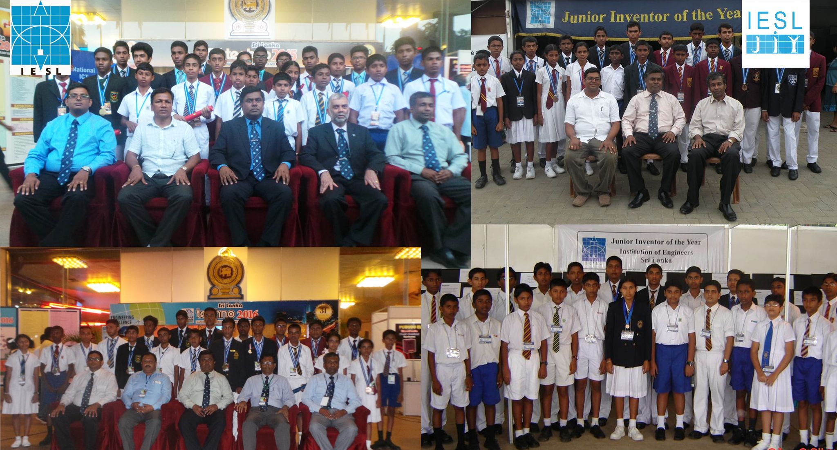
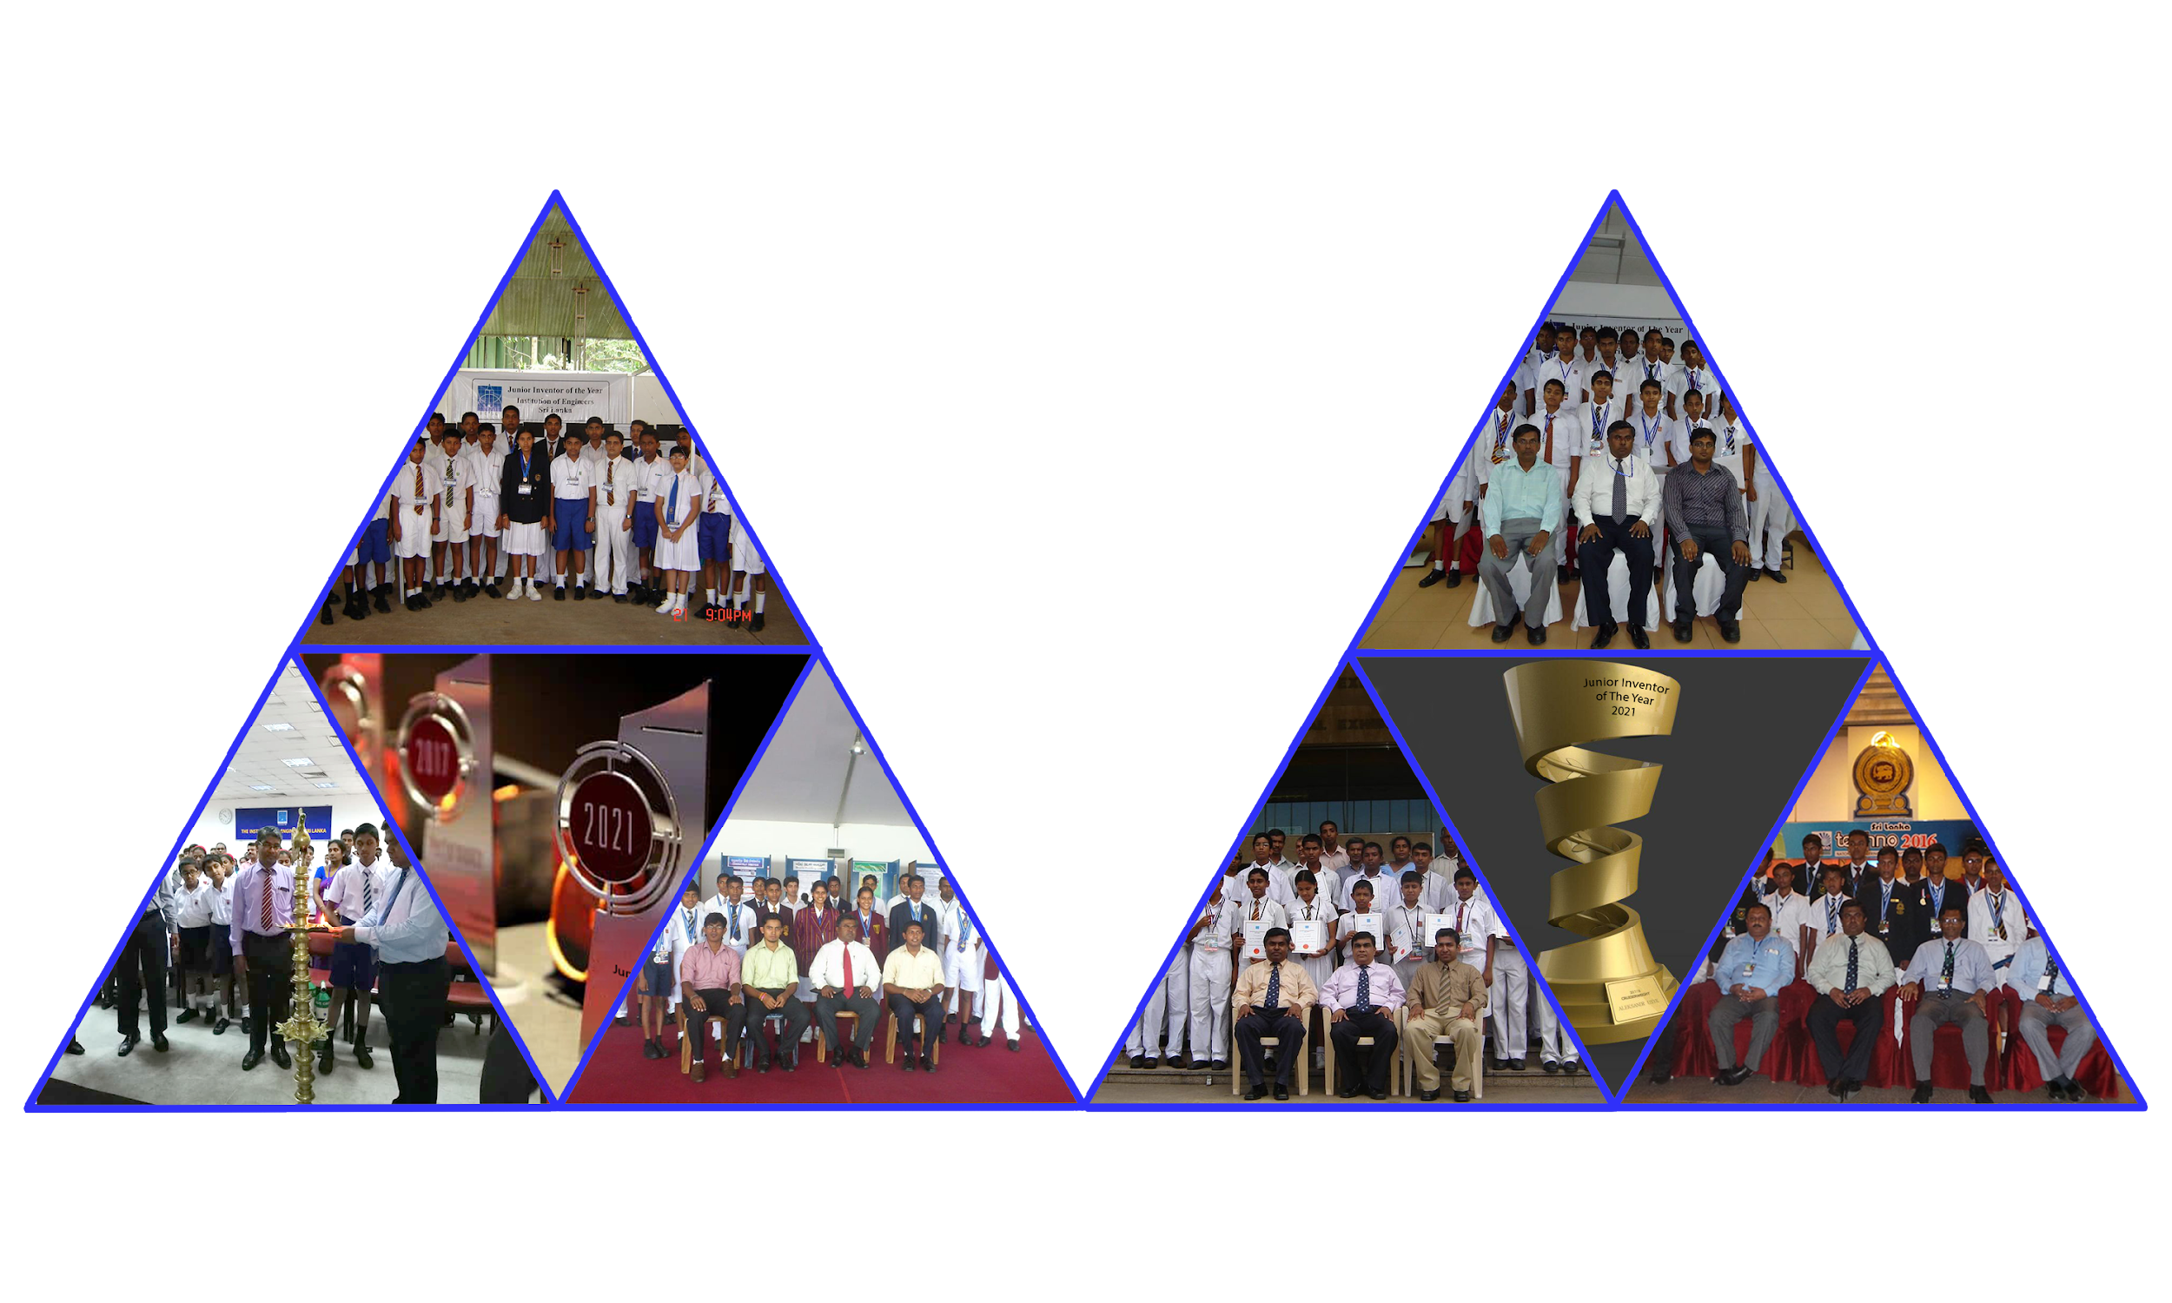
Introduction to Past Winners
IESL JIY
2021
16

Slide 17
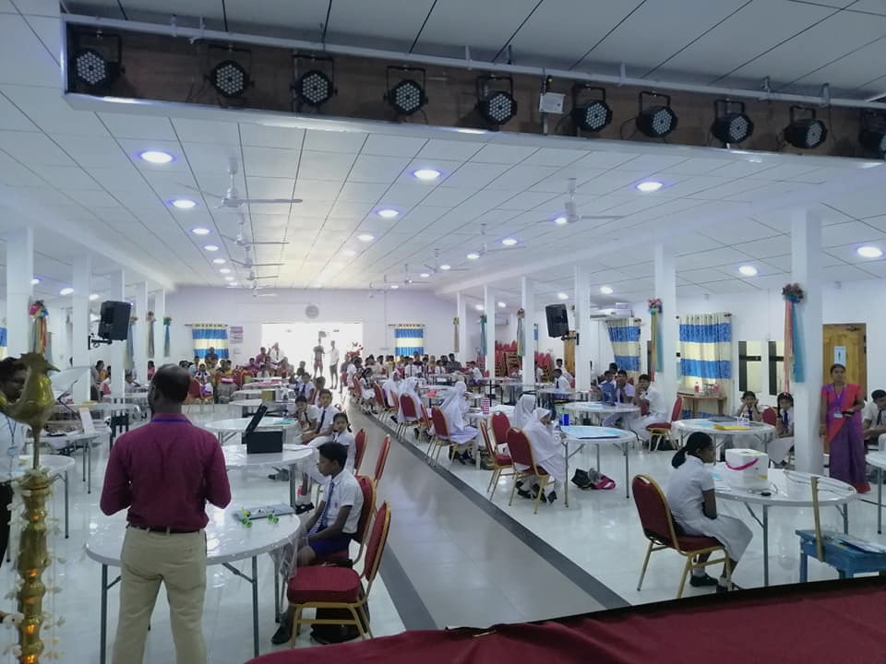
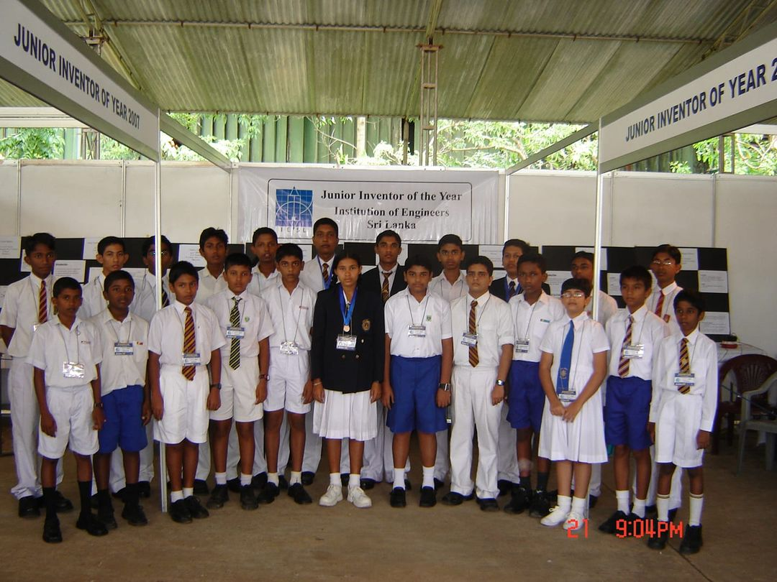
JIY WINNERS 2007
Yasith Kanchana Lokuge
Ananda College, Colombo 10
Intel ISEF 2008 Finalist, Atlanta, USA
Herbert Hoover Medal - International Exhibition for Young Inventors
Award for Mechanical Structural Design - Silver
Award for Safety & Healthy Enhancement – Bronze
‘Best m-Education & Learning’ award at the mBillionth Awards South Asia 2014, India.
IESL JIY
2021
17

Slide 18
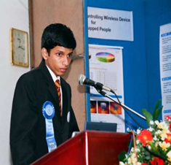
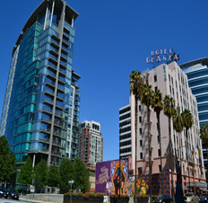
JIY WINNERS 2009
Ganindu Nanayakkara Ananda College, Colombo 10
Maduranga Karunajeewa Rajasinghe Central College, Ruwanwella
Intel ISEF Grand Award, San Jose, USA
Intel excellence Award
China Association for Science & Technology Award
Symantec Corporation Award
National Collegiate Inventors & Innovators Alliance/ The Lemelson
Foundation Award
Intel ISEF Finalist, San Jose, USA
Presidential award first place winner (Transport category)- SLIC
IESL JIY
2021
18

Slide 19
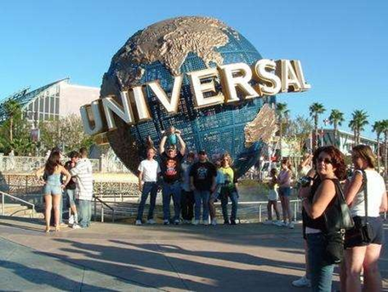

JIY WINNERS 2010
JIY WINNERS 2011
Timira Shanuka Thilakarathne
Ananda College, Colombo
Nipuna Kavishka Silva and Pipunika Vimanthi Silva
De Mazenod College, Kandana
Intel ISEF Finalist, Los Angeles, USA
Intel excellence Award in Computer Science
Intel ISEF Finalist, San Jose, USA
Presidential award first place winner (Transport category)- SLIC
IESL JIY
2021
19

Slide 20
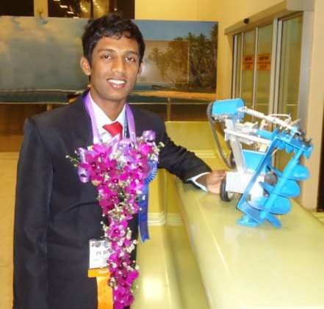
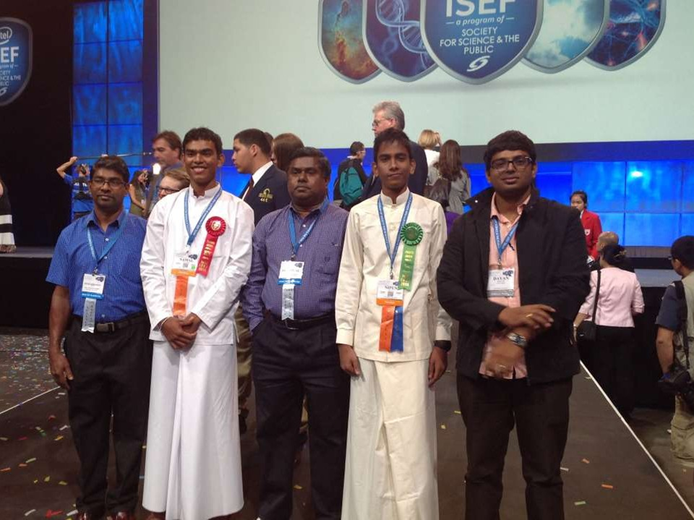
JIY WINNERS 2012
JIY WINNERS 2013
Pubudu Dinesh Kapuge
Mihinthale Maha Vidyalaya, Mihinthale
Namal Udara Piyasiri
Thambuththegama Central College, Thambuththegama
Intel ISEF Grand Award-Electrical & Mechanical Engineering- 1st Place, Arizona, USA
Special award from the Ashtavadhani Vidwan Ambati
Subbaraya Chetty Foundation
Intel ISEF Grand Award-Electrical & Mechanical Engineering
2nd Place, Los Angeles, USA
Special award from the American Intellectual Property Law
Association
Special award from U.S. Agency for International Development
IESL JIY
2021
20

Slide 21
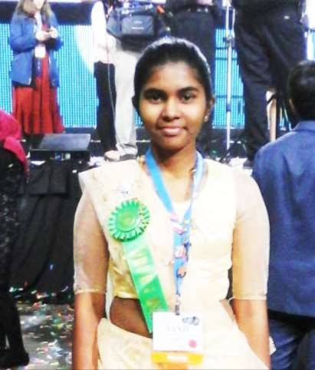
JIY WINNERS 2013
JIY WINNERS 2014
Nipun Kavishka Silva
De Mazenod College, Kandana
Sanju Subodha Sewwandi
Bomiriya Central College, Kaduwela
Intel ISEF Grand Award- Computer Science - 4th Place, Los Angeles, USA
Intel ISEF Grand Award - Engineering Mechanics - 4th Place
IESL JIY
2021
21

Slide 22
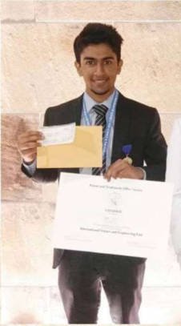

JIY WINNERS 2015
Abishek S. Gomas
Belvoir International College, Wellawaththa
Chamindu Jayasanka
Rajapaksha Central College
Third place “Embedded System” category
Won the dreamed copy of patent and Trademark Office Society for the unique project titled “Modified and Adjustable Crutches”
IESL JIY
2021
22

Slide 23
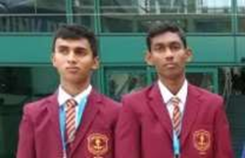
PERFORMANCE AT INTEL INTERNATIONAL SCIENCE & ENGINEERING FAIR
Shehan Kanishka & Ravindu
Sankalpa
SRPC Finalist
Grand award 4th place in the Category of Earth & Environmental Sciences
Award from King Abdul-Aziz & His Companions Foundation for Giftedness and Creativity
IESL JIY
2021
23
Notes:
intel antharjathika widya ha engineeru widya dakma

Slide 24
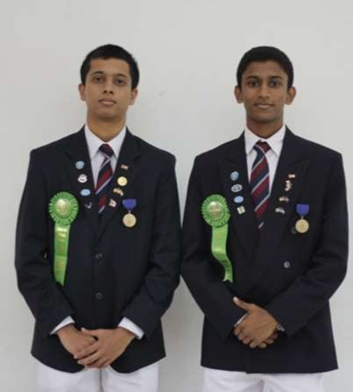
PERFORMANCE AT INTEL INTERNATIONAL SCIENCE & ENGINEERING FAIR
G Kavinda Bandara & K Gimhan Wijayawardana
From St Anthony's College, Kandy
Won a grand award in the category of Embedded Systems at the Grand Award Ceremony for their unique project titled ‘Smart Walking Stick for Blind (Golden i)’
IESL JIY
2021
24

Slide 25
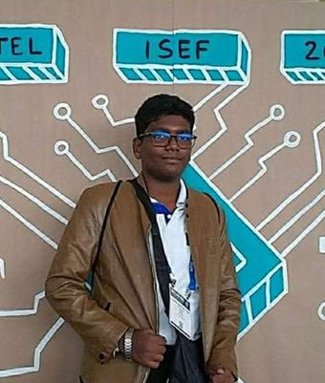
PERFORMANCE AT INTEL INTERNATIONAL SCIENCE & ENGINEERING FAIR
Rumal Induwara from Ananda National School, Chilaw
Won a grand award in the category of Microbiology for his research titled ‘Isolation of a Potential Microbial Agent for Controlling Dengue Vector Mosquitoes in Sri Lanka’.
IESL JIY
2021
25

Slide 26
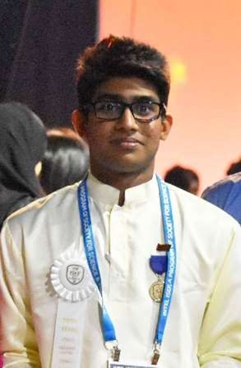
PERFORMANCE AT INTEL INTERNATIONAL SCIENCE & ENGINEERING FAIR
W A Kavith Budwin Udapola from
Sandalankawa Central College, Sandalankawa
Won a grand award in the category of Embedded Systems at the Grand Award Ceremony for their unique project titled ‘Smart Safe Gas Regulator
IESL JIY
2021
26

Slide 27
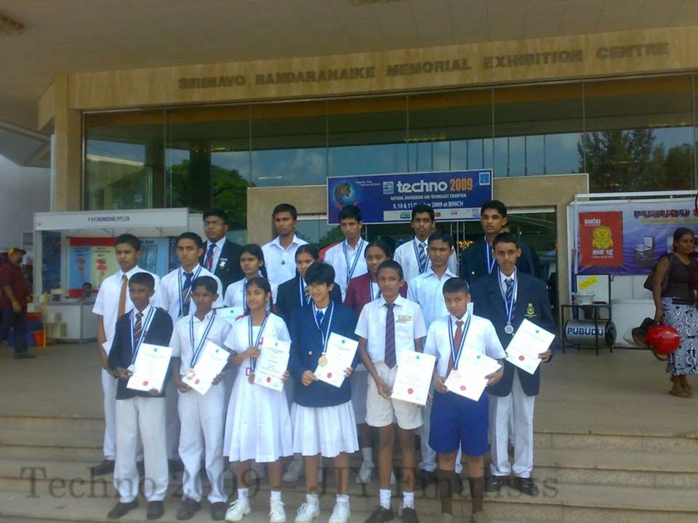
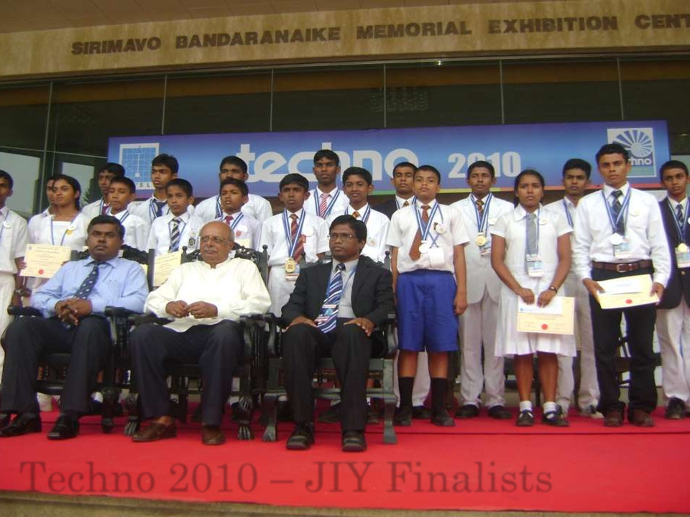
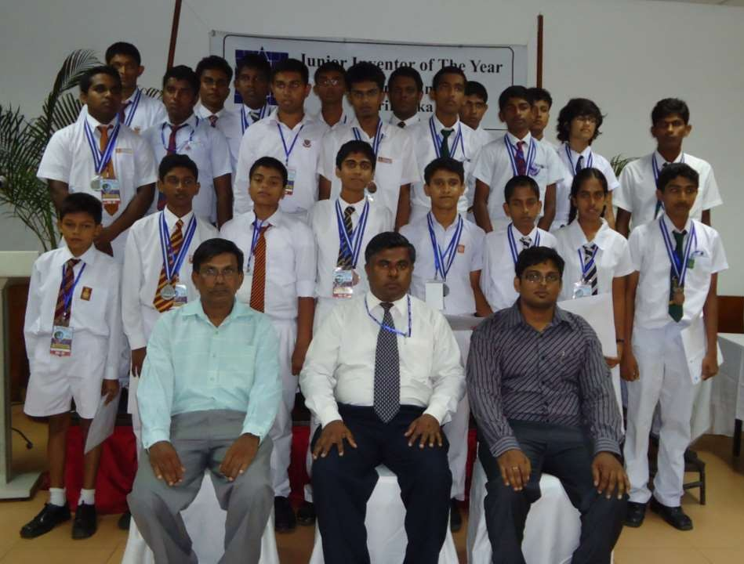
JIY FINALISTS ...
2009 finalists
2010 finalists
2011 finalists
IESL JIY
2021
27

Slide 28
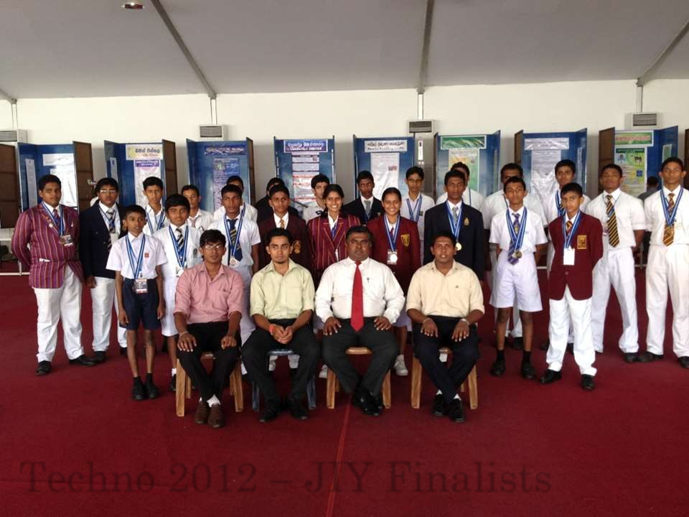
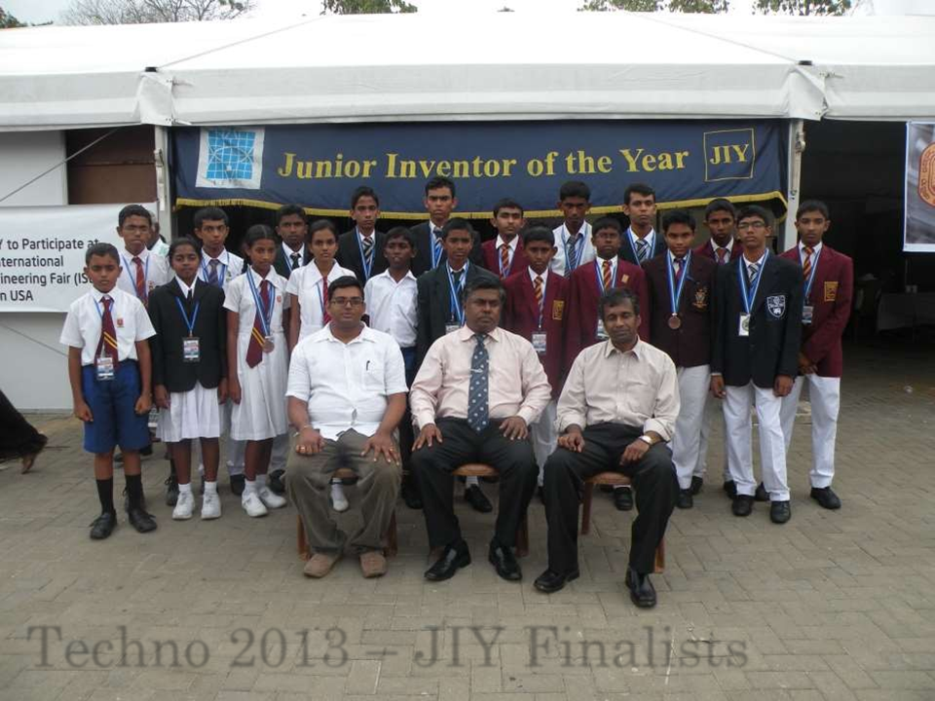
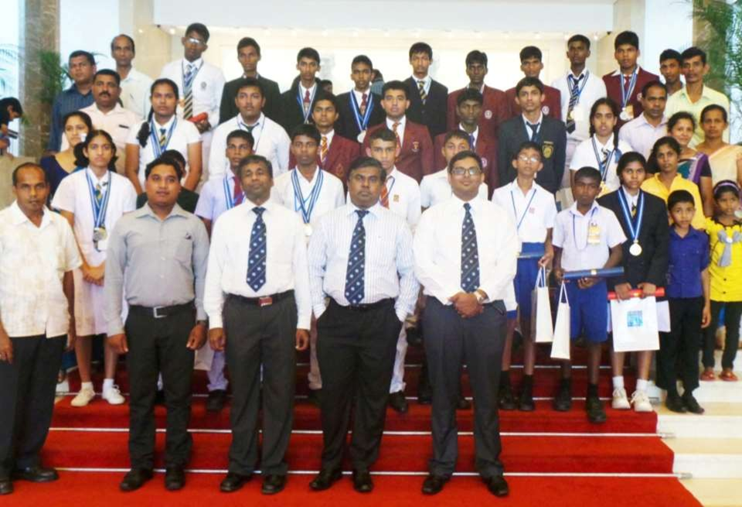
JIY FINALISTS ...
2012 finalists
2013 finalists
2014 finalists
IESL JIY
2021
28

Slide 29
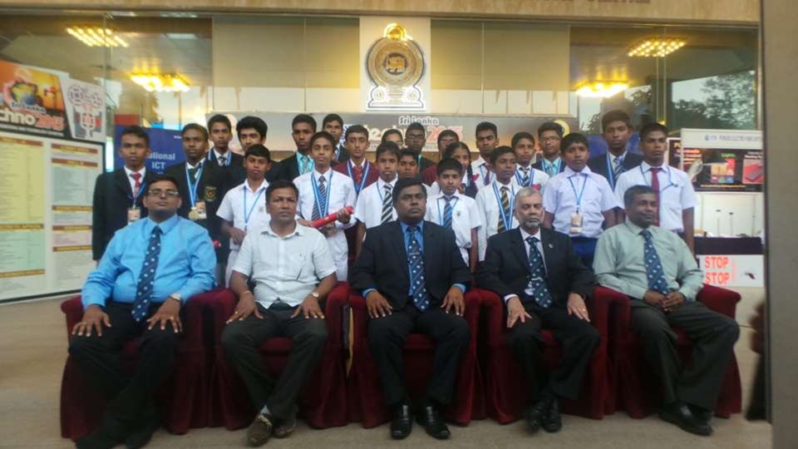
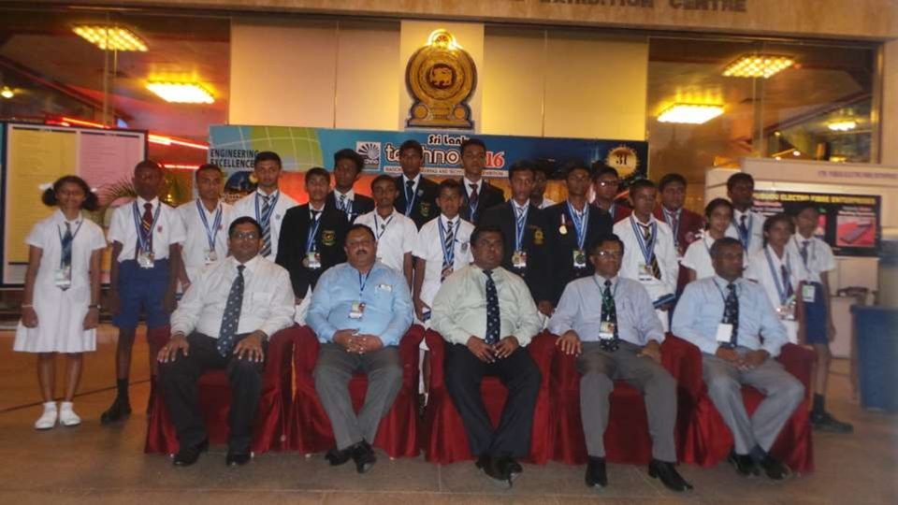
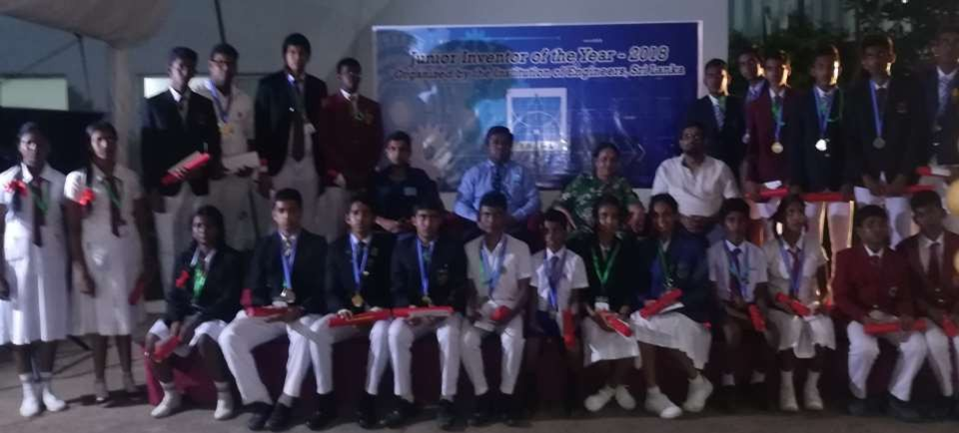
JIY FINALISTS ...
2015 finalists
2016 finalists
2018 finalists
IESL JIY
2021
29

Slide 30
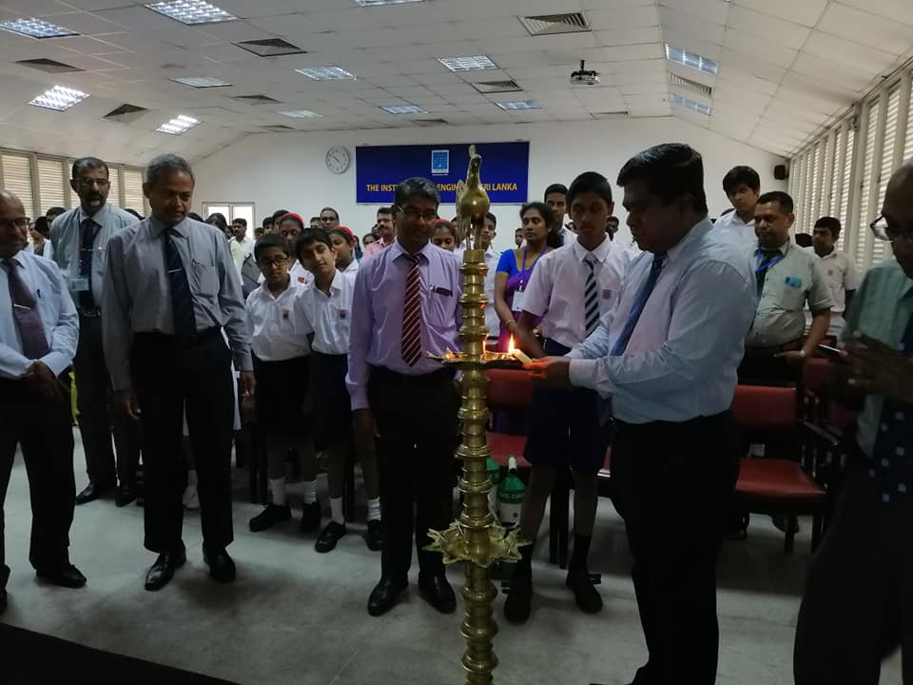

JIY FINALISTS ...
2019
2021
IESL JIY
2021
30

Slide 31
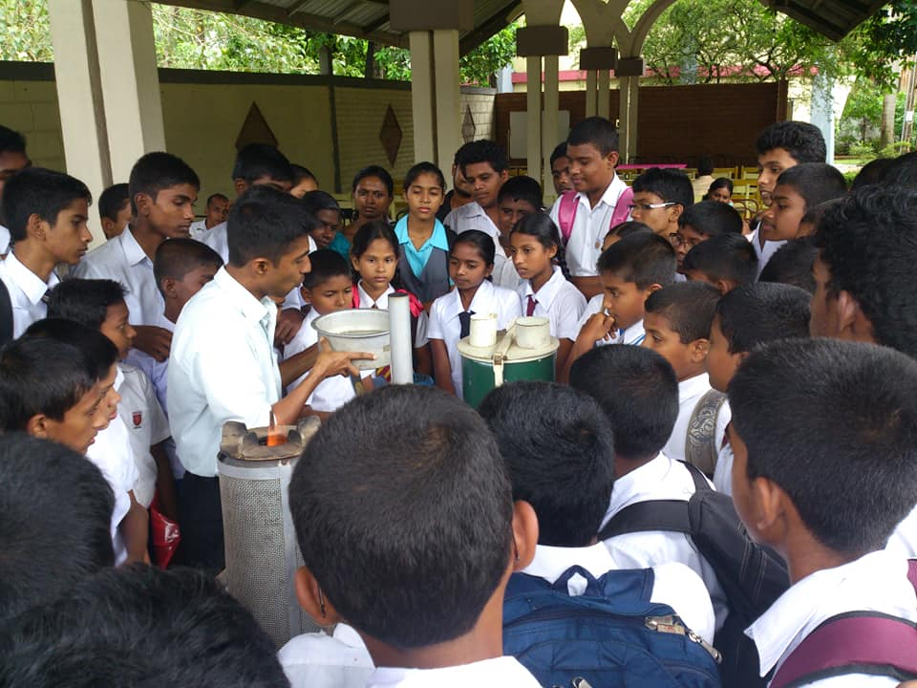
How to Prepare
Focus On
Engineering/Scientific Research instead of Invention
Conduct
Trials and Experiments
See to
A Literature Survey
Seek
Knowledge from Experts
Study
On available Devices, Mechanisms and Solutions
Maintain
IESL JIY
2021
A Log Book
31

Slide 32

How to Conduct A Research
Identify the Problem
Fabricate Your Design
Analyze and Compare the Results
Conclude
Prepare a Report
Test the Device
Discuss the Results
IESL JIY
2021
32

Slide 33
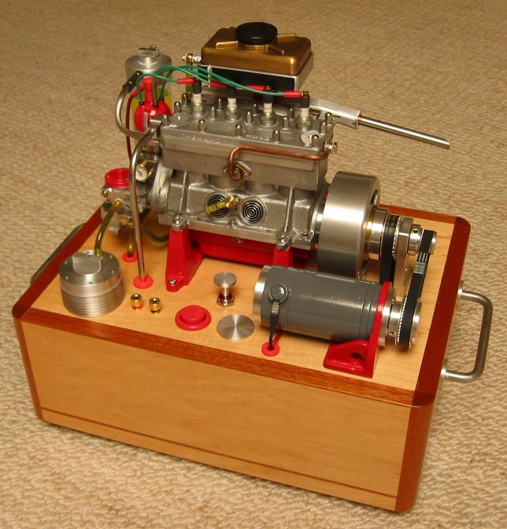
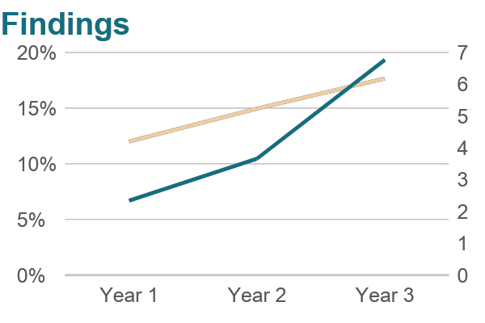
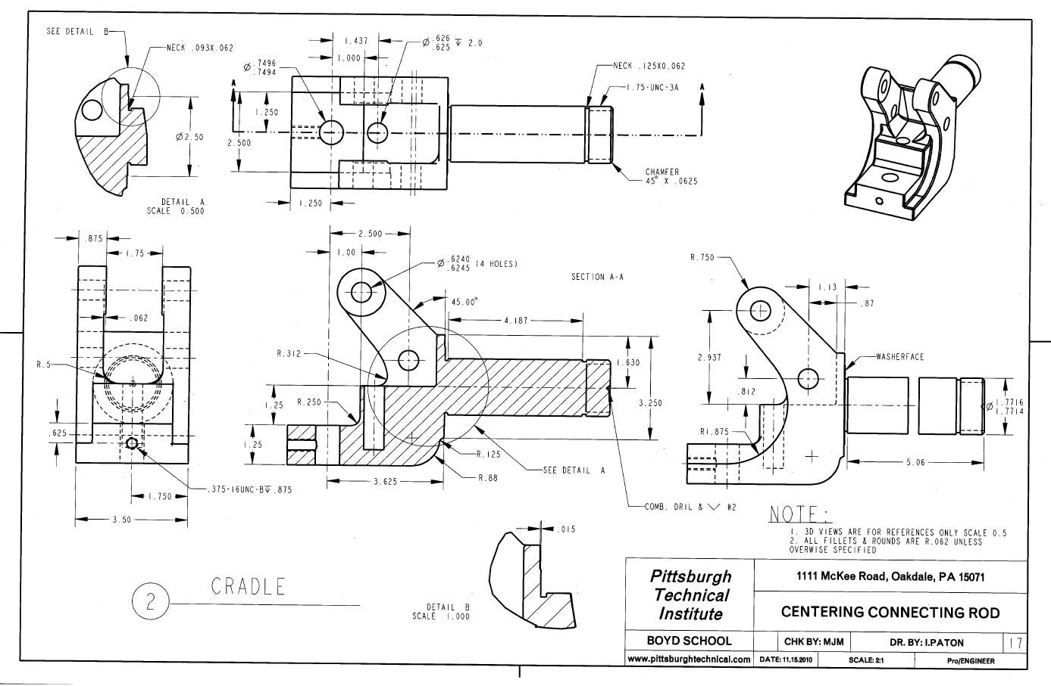
How to Prepare the Display for the Cubicle
Showcase Your
Physical Model
Summarize Your Findings
In Graphs
Show Drawings of Your
Design
Make Sure to Have your Logbook Present at the Cubicle, All the Time
IESL JIY
2021
33

Slide 34
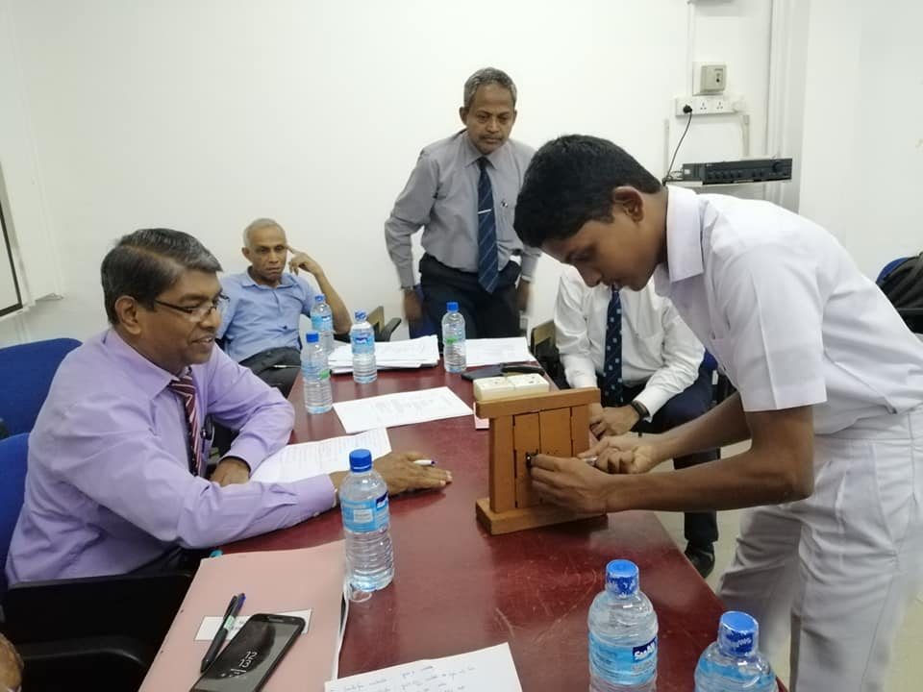
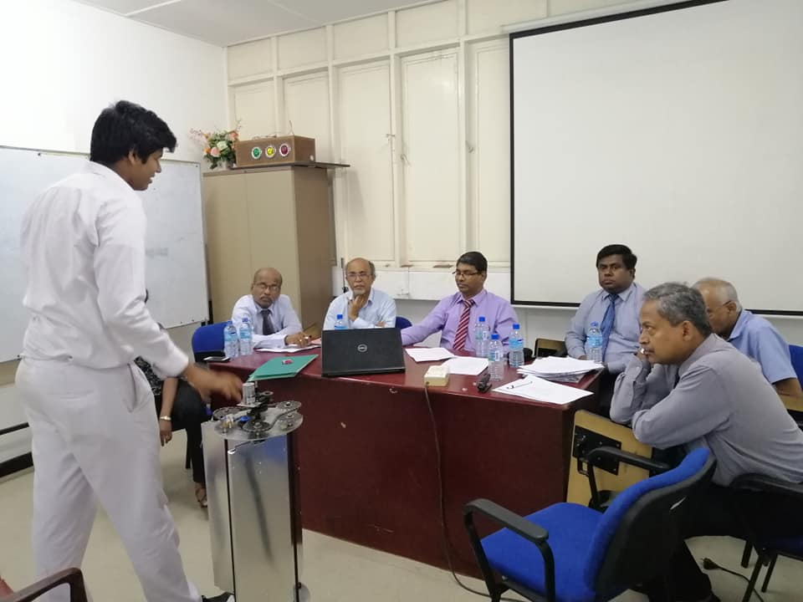
INTERVIEWS
Answer in English ( taxi driver English is good enough)
If difficult use a translator, (You may need a translator to understand difficult accent and some words)
Questions are open-ended
Don’t memorize a speech
IESL JIY
2021
34

Slide 35

You Will Be Judged On,
For the lab or field work and theory. (not just library research or ‘gadgeteer’)
On Genuity of
Your Work
Your knowledge about
the display
Work you have conducted within a time of 1 year
Involvement with the previous work
IESL JIY
2021
35

Slide 36
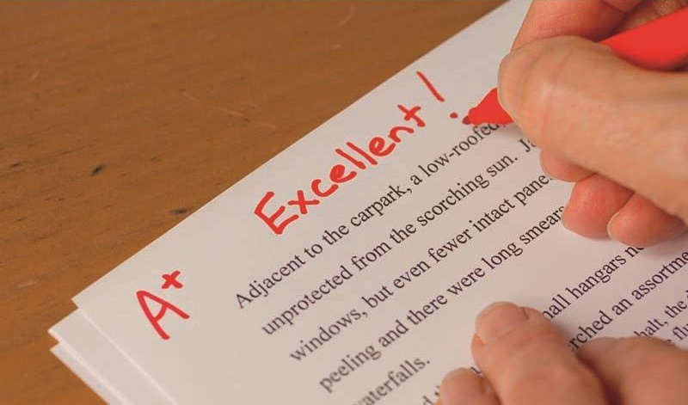
Marking Criteria
Criteria | Considered Factors | Marks For Individual Participant | Marks For a Team of Participants
Creativity | Investigation | 30 | 25
 | Data collection
 | Research approach
Engineering goals | Clear objective | 30 | 25
 | Workable
 | Economical
 | Usefulness
Thoroughness | Scope | 15 | 12
 | completeness
 | Repeatable results
 | Awareness of existing solutions
 | Time spent
IESL JIY
2021
36

Slide 37
Marking Criteria (Cont.)
Criteria | Considered Factors | Marks For Individual Participant | Marks For a Team of Participants
Skill displayed | Experimental & Design Skills | 15 | 12
 | Usage of instruments
 | Skill in Seeking Help
Clarity | Clarity of the Explanation | 10 | 10
 | Clarity of the Logbook and Notes
 | Clarity of the Display
Teamwork | Clear Distribution of Work | - | 16
 | Well Balanced Work Distribution
 | Coordinated Effort by All Members
 | Knowledgeability of All Members
IESL JIY
2021
37

Slide 38



THANK YOU!
IESL JIY Committee
jiy@iesl.lk
Deputy Executive Secretary (Education),
The Institution of Engineers Sri Lanka,
No 120/15,
Wijerama Mawatha,
Colombo-07.

Slide 39
IESL - JUNIOR INVENTOR OF THE YEAR - 2021
Register Now!!!

